Slide 1

Pharmacy Analytics Lakehouse
From Raw Data to Intelligent Healthcare Insights
Guru Saran Satsangi Peddinti

Slide 2
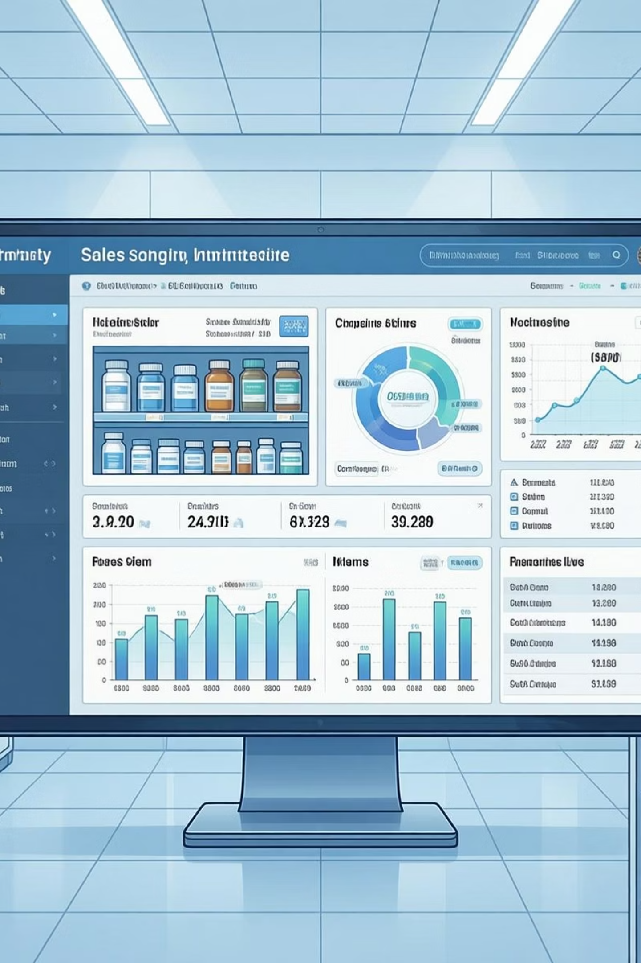
Domain Context: Retail Pharmacy & Healthcare Supply Chain
Non-Clinical Data Focus
This project exclusively deals with non-clinical, non-sensitive pharmacy operational data, ensuring patient privacy and data security.
Operational Challenges
Pharmacies face constant battles with inventory management, stock-outs, and expiry losses, directly impacting patient care and profitability.
Analytics for Medicine Availability
Leveraging data analytics is crucial to optimizing medicine availability, a critical factor in public health and patient satisfaction.

Slide 3
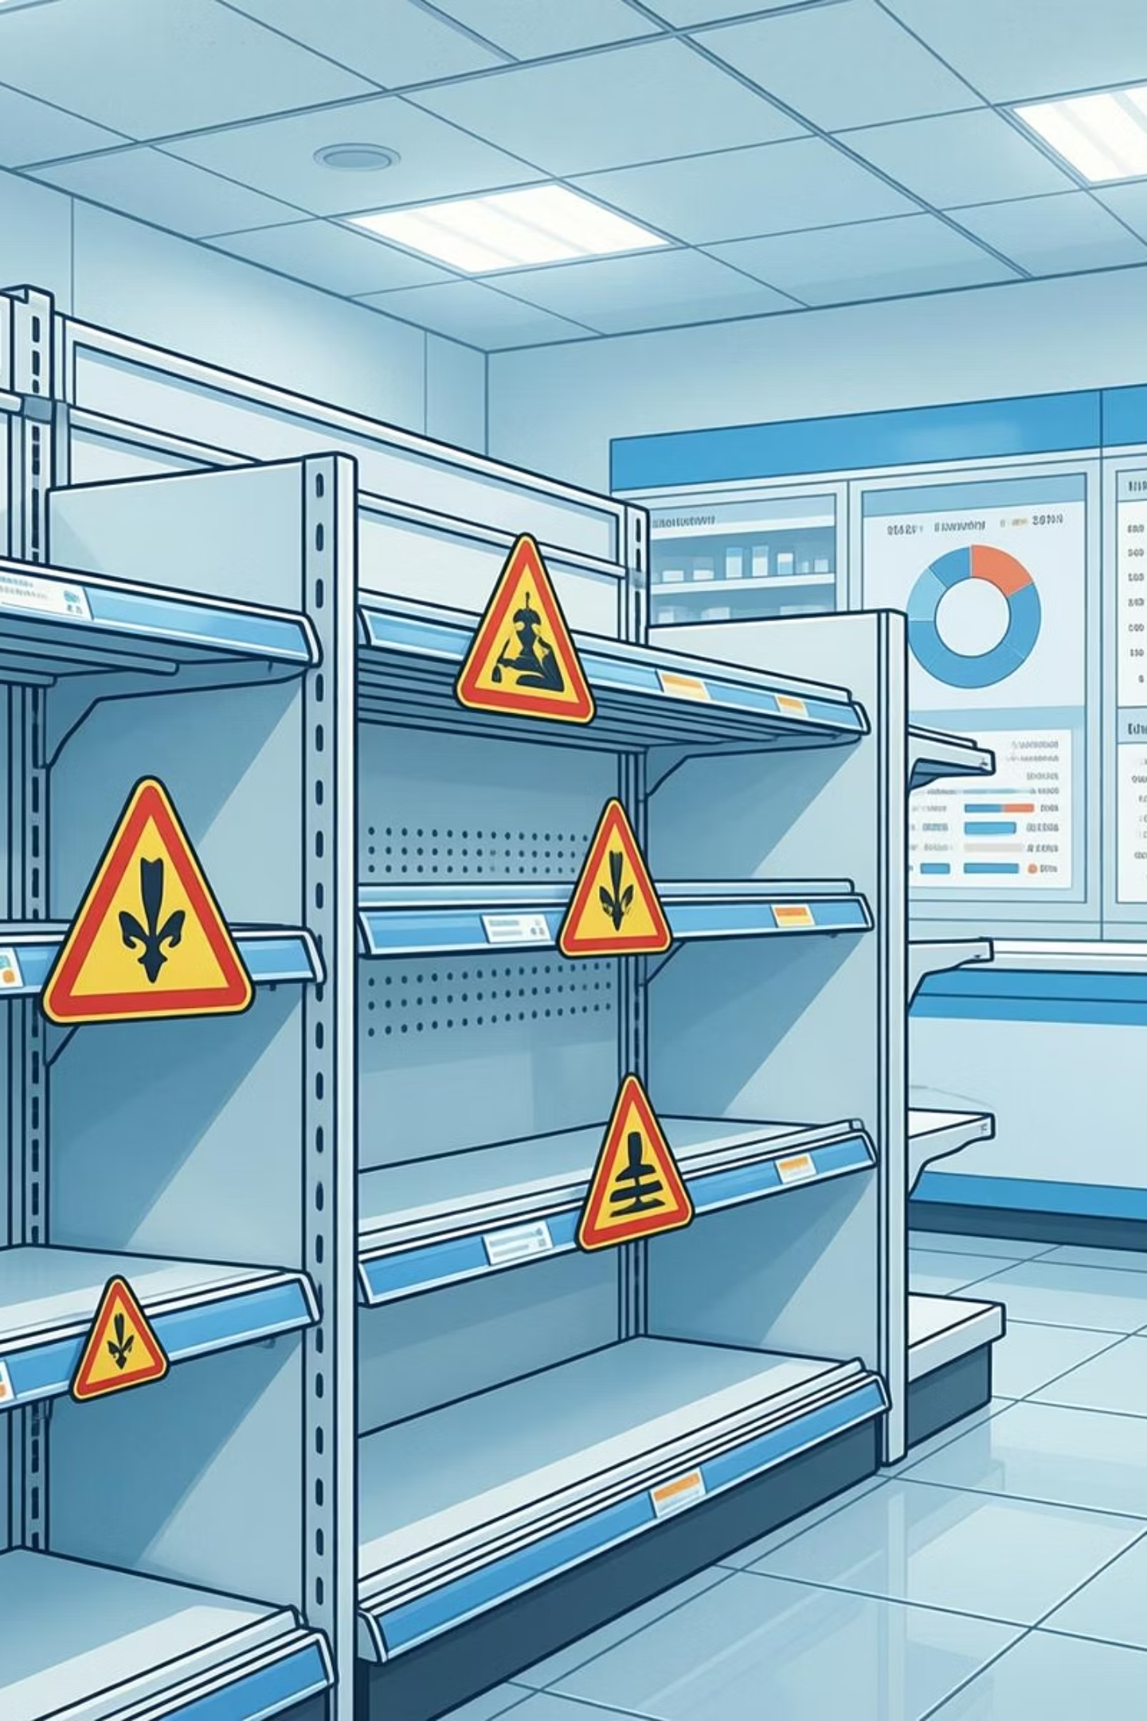

The Problem: Transforming Pharmacy Data into Actionable Insights
How can raw pharmacy transaction and inventory data be transformed into a governed analytics platform to address critical operational challenges?
Reduce Stock-Outs
Ensure essential medicines are always in stock, preventing missed sales and patient inconvenience.
Minimize Expiry Losses
Implement proactive measures to reduce financial losses from expired inventory.
Improve Medicine Availability
Optimize inventory levels to meet demand consistently and efficiently.
Optimize Revenue
Maximize category and product-level revenue without relying on sensitive patient or clinical data.

Slide 4

Data Overview: Synthetic Pharmacy Transactions
This project utilizes a synthetic dataset of 1 million pharmacy records, meticulously designed to mimic real-world pharmacy operations while maintaining data privacy.
Key Attributes:
Batch Number
Form (Tablet, Syrup, Injection, etc.)
Quantity, Amount
Medicine Name, Combination
Manufacturer
Category (e.g., Pain Relief, Antibiotics)
Manufacturing & Expiry Dates
Price

Slide 5









Tools & Technologies Used
This project was built entirely on Databricks, leveraging its unified Lakehouse capabilities end to end.
Core Tools & Tech used
Databricks Workspace
Databricks Notebooks
Apache Spark (Databricks Runtime)
Central environment for notebooks, jobs, dashboards, and versioned development
Used for data generation, Bronze/Silver/Gold transformations, exploratory analysis, and ML preparation
Distributed data processing, PySpark DataFrames & Spark SQL, large-scale transformations on 1M+ records
Delta Lake
Databricks SQL
Databricks Dashboards
ACID-compliant storage, Bronze–Silver–Gold Medallion Architecture, schema enforcement & evolution
Analytical queries, KPI computation, powering dashboards and visualizations
Interactive analytics, category-wise and expiry-risk insights, business-facing visual layer
Databricks Jobs (Workflows)
Unity Catalog (Governance)
MLflow (Databricks Native)
Orchestrated pipelines, Bronze → Silver → Gold execution flow, production-style scheduling
Logical data organization, schema-level separation, foundation for secure analytics
Model experimentation, metric tracking, regression & classification workflows

Slide 6
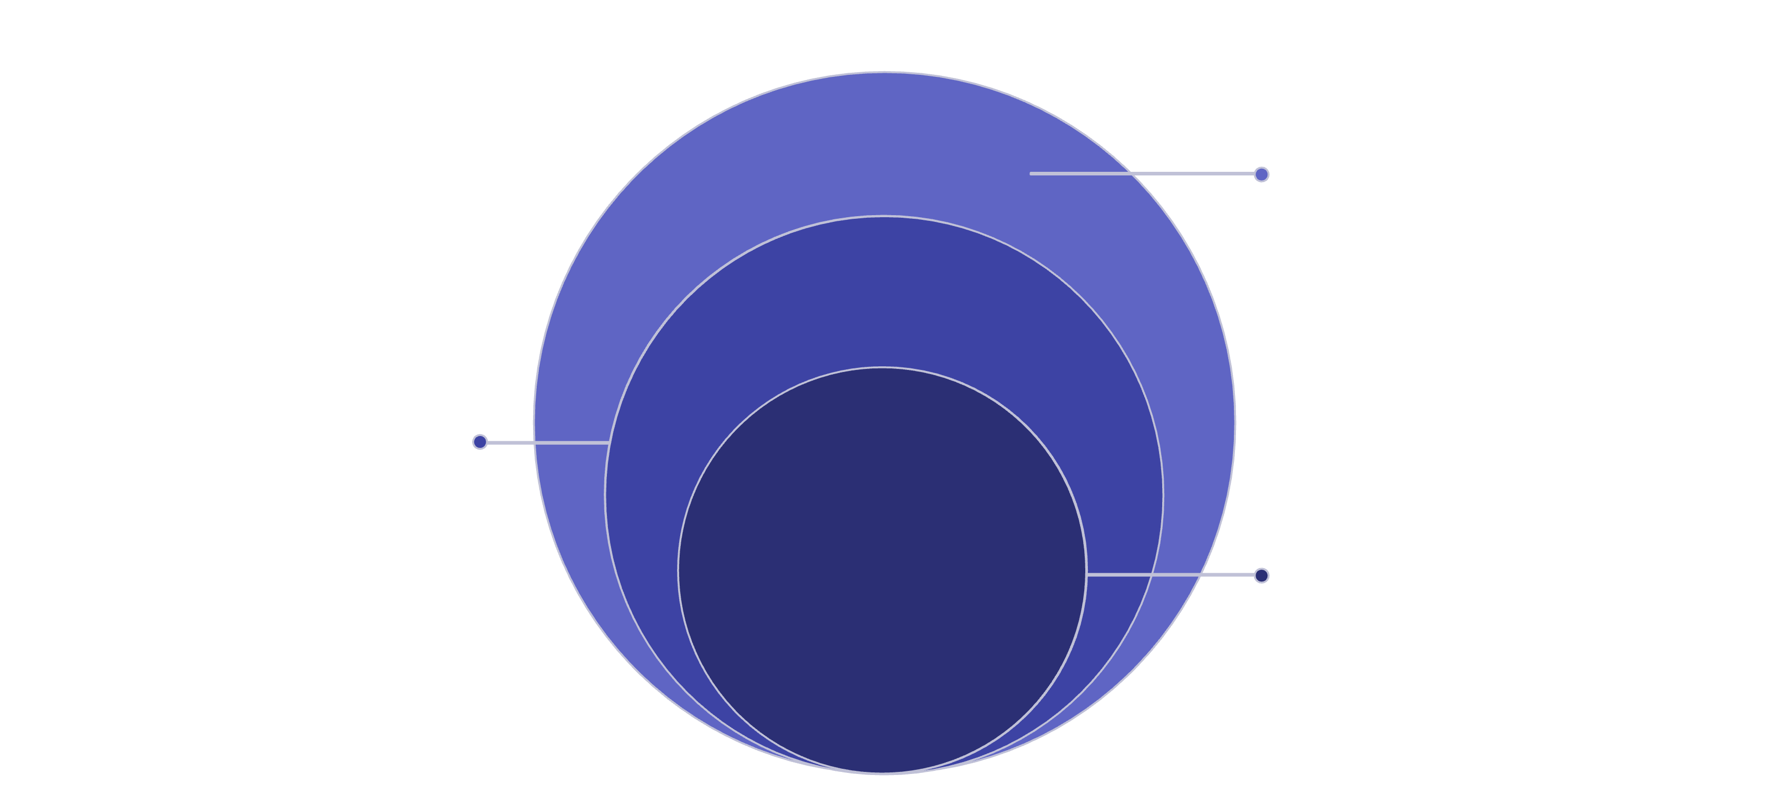
Gold, ML & Dashboards
Serve analytics, models, and visual insights
Bronze & Silver
Clean, validate, and structure curated data
Raw CSV
Ingest unprocessed files from sources
The Lakehouse architecture provides a robust and scalable framework for data processing, from raw ingestion to advanced analytics and machine learning applications.

Slide 7



Lakehouse Architecture Layers
Our Lakehouse architecture organizes data into distinct layers, each serving a specific purpose in transforming raw data into actionable intelligence.
Bronze Layer (Raw)
Silver Layer (Cleaned)
Gold Layer (Curated)
The initial ingestion point for raw, unprocessed data from various sources, maintained in its original format with minimal transformation (append-only).
Data undergoes cleaning, validation, and enrichment here, creating a single source of truth that is structured and ready for business use cases.
Highly aggregated and refined data, optimized for dashboards, reporting, and advanced analytics, providing key performance indicators (KPIs) and business insights.

Slide 8

Bronze Layer: Raw Data Ingestion
The Bronze layer serves as the initial landing zone for all incoming raw data, preserving its original format and ensuring immutability.
Append-Only Ingestion
Raw CSV files are ingested as append-only events, capturing every data point without alteration.
Minimal Transformation
Data undergoes minimal schema inference and conversion to Delta Lake format, maintaining fidelity to the source.
Ingestion Timestamp
Each record is stamped with an ingestion timestamp for auditing and traceability, crucial for data governance.
Delta Lake Format
Leveraging Delta Lake provides ACID transactions, schema enforcement, and time travel capabilities from the very first layer.

Slide 9

Silver Layer: Clean & Enriched Data
The Silver layer refines the raw data, applying data quality checks and enriching it for business readiness.
Data Quality Checks
Duplicate Removal
Validation rules are applied to ensure data integrity and consistency across all attributes.
Identification and elimination of duplicate records to ensure accurate analysis.
Date Normalization
Expiry Risk Flags
Standardization of date formats for consistent time-series analysis.
Introduction of flags to identify medicines approaching their expiry date, enabling proactive management.
Business-Ready Schema
Transformation into a user-friendly schema, optimizing it for downstream analytics and reporting.

Slide 10




Gold Layer: Business Aggregates
The Gold layer provides highly refined, aggregated data tailored for specific business use cases, dashboards, and advanced analytics.
Category-Level KPIs
Aggregated metrics like total sales, inventory value, and profit margins by medicine category.
Product-Level Metrics
Detailed performance indicators for individual medicines, including sales velocity and stock turnover.
Expiry Risk Summaries
Summaries of near-expiry inventory, highlighting categories and products most at risk.
Dashboard-Ready Tables
Optimized tables designed for fast query performance in business intelligence tools.

Slide 11
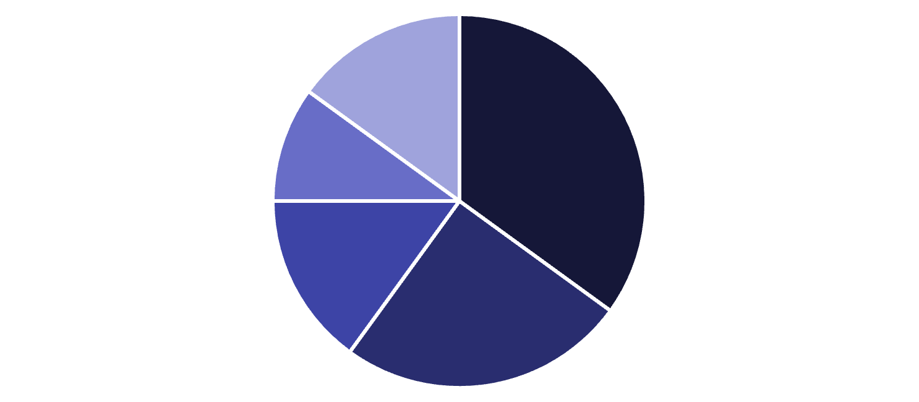
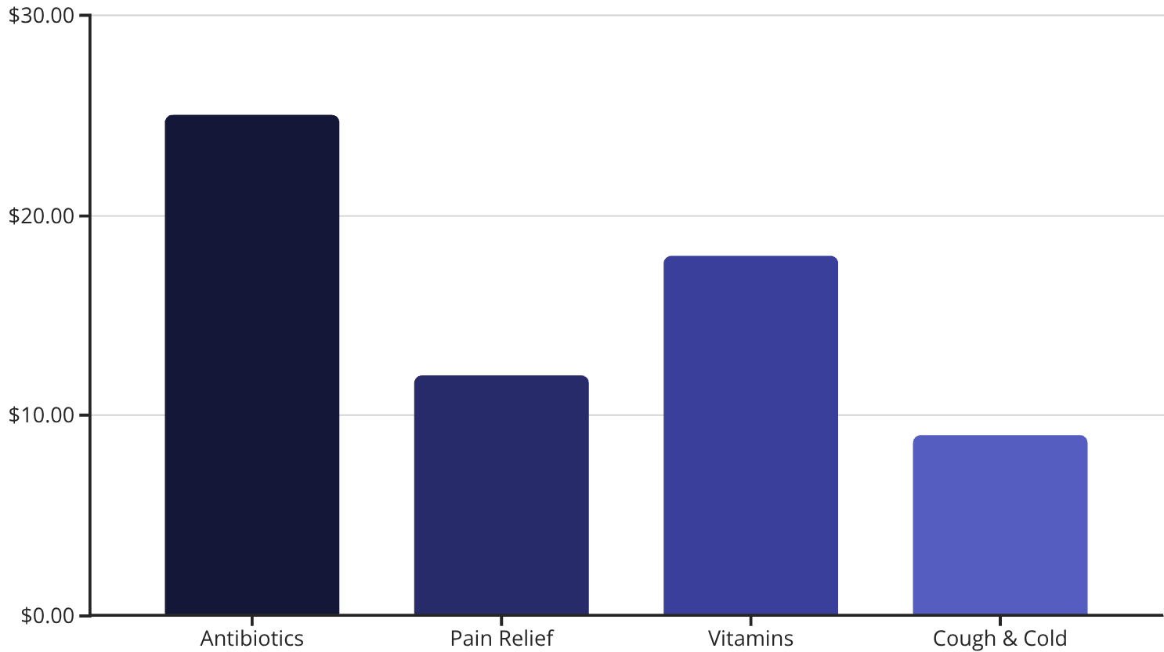
Analytics & Dashboards: Driving Business Insights
Visual dashboards provide a comprehensive view of pharmacy operations, enabling data-driven decision-making.
Pain Relief
Antibiotics
Vitamins
Cough & Cold
Others
Category distribution: Understanding the proportion of different medicine categories in inventory.
Average price by category: Identifying high-value and high-volume product segments.
Interactive filters enable deep dives into specific products or manufacturers.
Key Performance Indicators (KPIs) track inventory health and sales trends.

Slide 12


About the Author
An AI/ML enthusiast with a strong foundation in data engineering and analytics, building real-world healthcare data platforms inspired by hands-on pharmacy operations. This project reflects a passion for transforming complex data into actionable insights, driving efficiency and better healthcare outcomes.
Connect with me:

